Slide 1
Robophysics and nano-analysis workshop
Ram Avinery, July 25th/26th 2021
INASCON

Slide 2
On The Agenda
About me
Robophysics inspiration
Review of simulation code
Independent work
Mean-square-displacement analysis
Independent work
Tomorrow: static and dynamic light scattering analysis

Slide 3
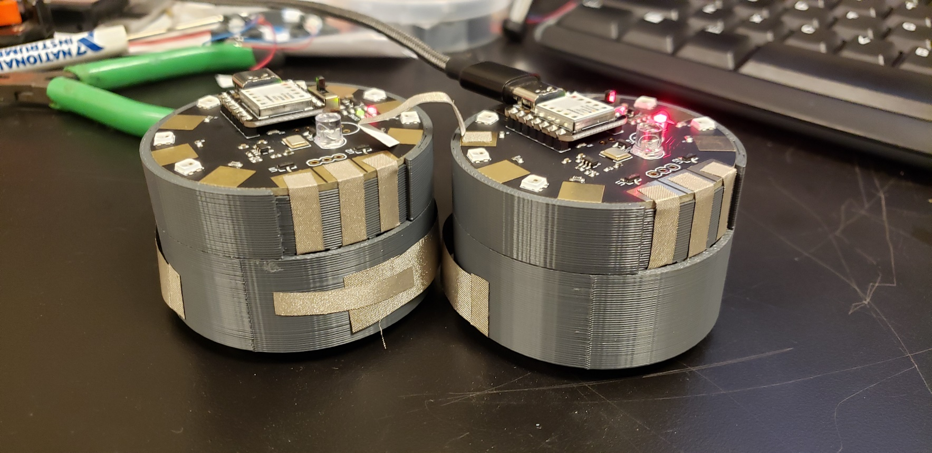
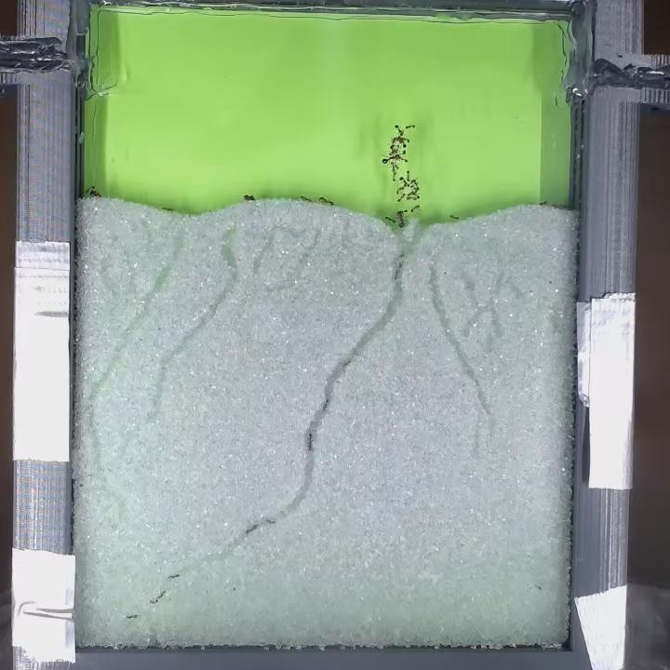
About Me
PhD in Physics from Tel-Aviv University under the supervision of Prof. Roy Beck-Barkai https://www.becklab.sites.tau.ac.il/
Studied (broadly):
Disordered Proteins
Nanometric self-assembled structures
Nanoparticle Interactions
Novel Entropy Computation
Currently post-doc @ CRAB Lab – Georgia Institute of Technology, GA, USA https://crablab.gatech.edu/
Studying robophysics, algorithmic-matter, natural and synthetic collectives (ants, robots)

Slide 4
Goal
Gain a better understanding of typical nano-world analysis tools:
Mean-square-displacement
Static Light Scattering
Dynamic Light Scattering
These will be explored by applying to simulated robotic matter, as well as thermodynamic hard discs
Our research question for the workshop – does the programmed gait modulate inter-particle interaction?

Slide 5
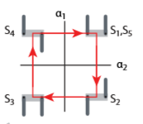
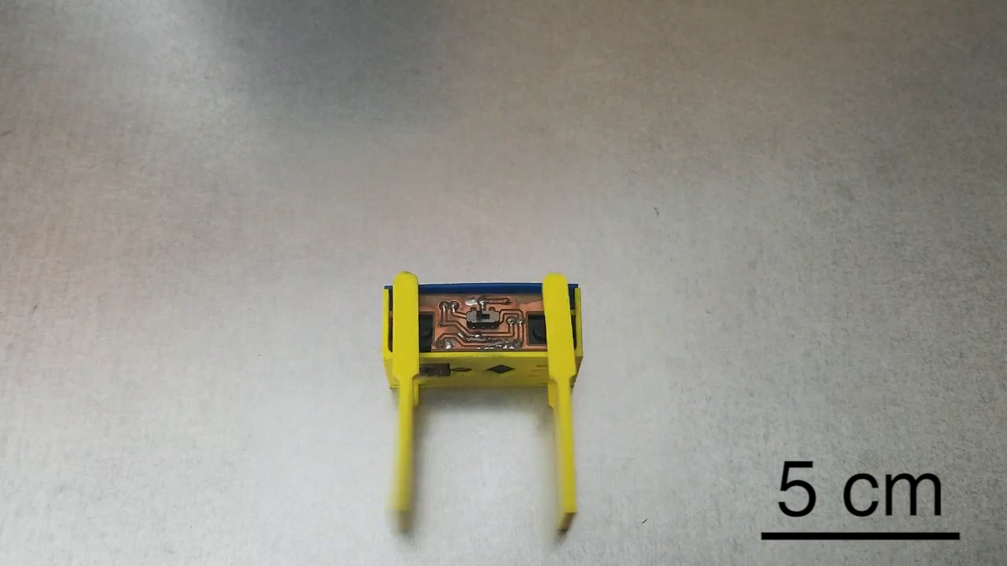
Robophysics Inspiration – Smarticles
Gait:
A pattern of limb movement
In our case, gait will be a periodic pattern of actuation

Slide 6
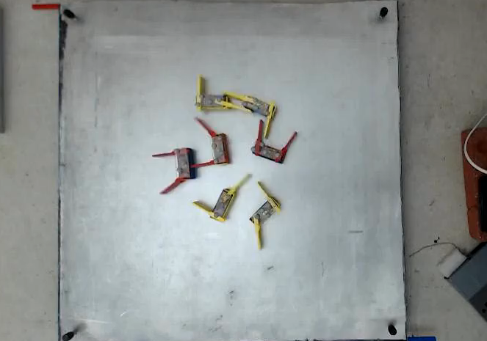
Robophysics Inspiration – Smarticles

Slide 7
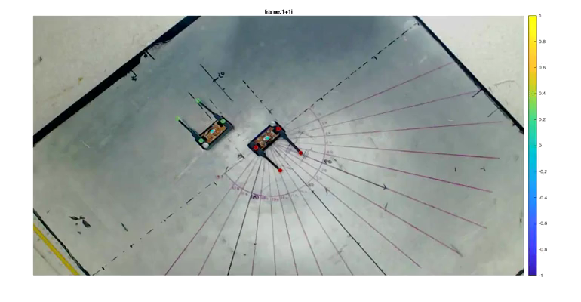
Robophysics Inspiration – Smarticles

Slide 8
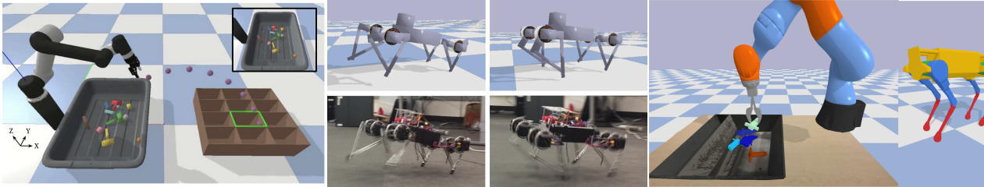
Physics Simulation
We will be using PyBullet, the python interface to a physics simulator widely used in robotics research https://pybullet.org/
The simulation is in a 3d world, but we will be confining the system to 2d

Slide 9
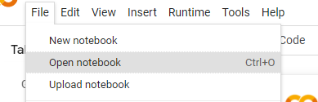
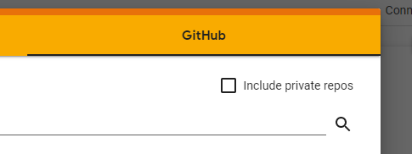
Getting Started
*This will require a Google account
Open a browser, and open https://research.google.com/colaboratory/ (you can also Google “colab”)
Sign in using your Google account
Click on File menu, then “open notebook”
Choose “GitHub”
Enter: https://github.com/abinary/INASCON2021
Then choose notebook “SetupColab.ipynb”

Slide 10
Getting Started
Alternatively, open: https://colab.research.google.com/github/abinary/INASCON2021/blob/main/SetupColab.ipynb
The notebook has one cell Run it (click play button ) and follow the instructions to connect your Google Drive

Slide 11

Getting Started
Once it is done (look for green “v” mark next to the play button) open https://drive.google.com
Go to the “INASCON2021” folder
Right click on “SmarticleSimNotebook.ipynb”
“Open With” $→$ “Google Colaboratory”
Run the first two cells, follow instructions to connect Google Drive again
* The first time you run the first cell is going to take a few minutes

Slide 12
Getting Started
Once it is done (look for green “v” mark next to the play button) open https://drive.google.com
Go to the “INASCON2021” folder
Right click on “SmarticleSimNotebook.ipynb”
“Open With” $→$ “Google Colaboratory”
Run the first two cells, follow instructions to connect Google Drive again
* The first time you run the first cell is going to take a few minutes

Slide 13

Independent Work
Set output prefix (“recording_prefix”) to “output/something”
Design your own gait (function “Gait” in class “Smarticle”)
This would require running two cells every time (one to update the class)
Use a Google Drive window to view the output video
Once you’re satisfied, test with more bots
Set as you wish: N ($≤$ 100), sim_time ($≤$20), box_size ($≥$0.5 , $≤$20) reasonable values in parenthesis

Slide 14

Mean-Square-Displacement (MSD)
Mean-square-displacement characterizes the motion of particles at varying time-scales
MSD$(t)$ = $\left\langle {\left(\overline{x}\left(t\right)−\overline{x}\left(0\right)\right)}^{2}\right\rangle$ Ensemble average
Two useful regimes:
Diffusive $\left\langle {\overline{x}\left(t\right)}^{2}\right\rangle =Dt$
Ballistic (no acceleration) $x\left(t\right)=vt$ $x^{2}\left(t\right)=v^{2}t^{2}$

Slide 15
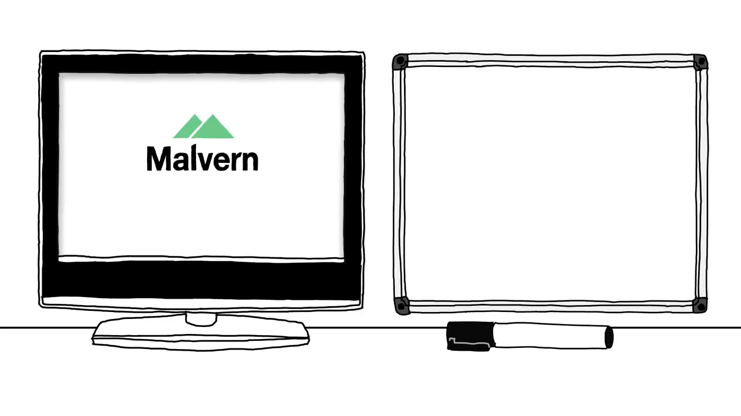
Mean-Square-Displacement (MSD)
https://www.malvernpanalytical.com/en/products/product-range/nanosight-range/nanosight-lm10

Slide 16

Mean-Square-Displacement (MSD)
https://www.youtube.com/watch?v=0_YAR5n0RkU
Orbit Research Associates

Slide 17

Code
In Google Drive, “INASCON2021” folder
Right click on “MSDAnalysis.ipynb”
“Open With” $→$ “Google Colaboratory”
Run the first cell, and follow instructions to connect Google Drive again

Slide 18
Independent Work
Observe MSD trends for various systems
Bounded random walk (in the notebook)
Data in the “data” folder for diffusing hard-discs
More advanced: Load and align data recorded in difference sampling interval
Data in the “data” folder for two difference Smarticle gaits
Your own generated trajectories

